Slide 1
P4XT Transponder Project Workshop
Open Research Institute

Slide 2
WHY DO THIS?
There is No ready to Fly Payload
Analog Transponders have Serious Shortcomings
Inefficient use of bandwidth
Subject to hi-jacking
Interference
Satellite Disaster Capability is virtually non-existent
Paper Designs and Demos are Not enough

Slide 3
PROJECT GOALS
SPACE BASED TRANSPONDER (P4XDMT)
All Digital Design
Fully Verified and Validated Design
Read for Final Adapter for Spaceflight
LOW-COST MODEM (P4XM)
Core of low-cost Earth Station Terminal
Full DVB-S2 Receiver
GPS Derived Reference and station clock
Standalone Operation (no separate PC required)
L-BAND IF Inputs and Outputs
< $ 250 Target Price

Slide 4
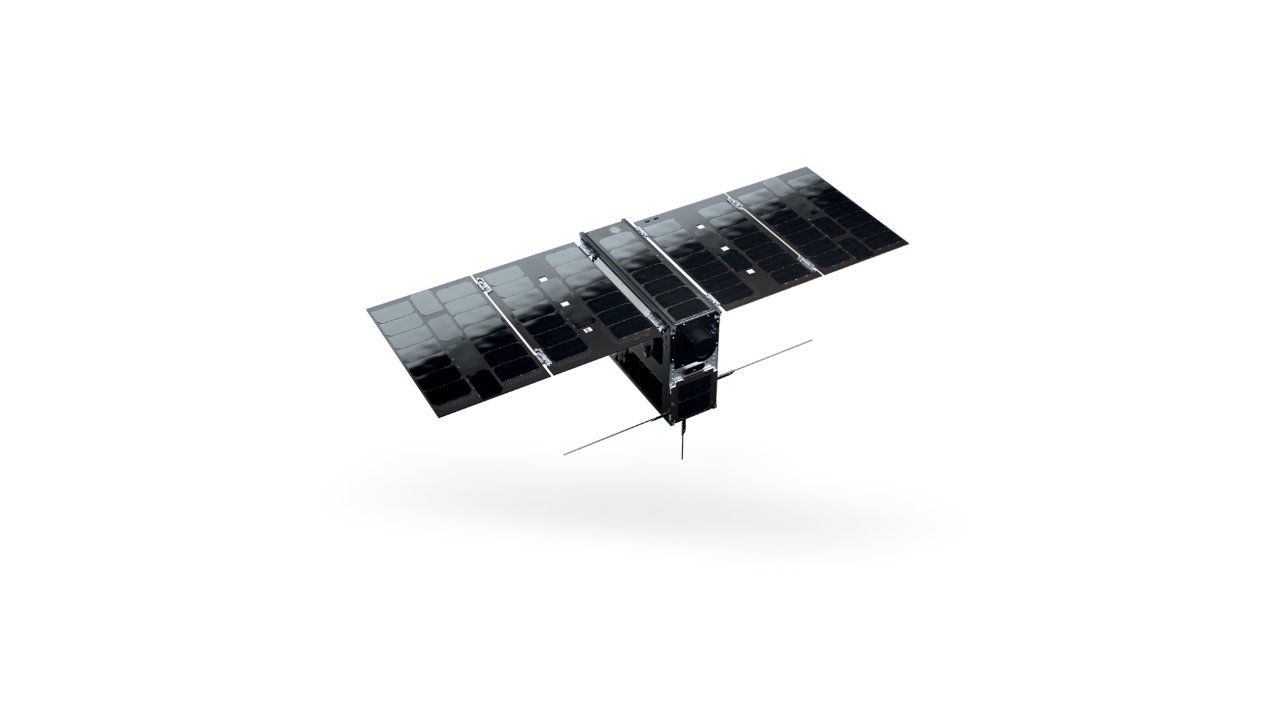

6U CUBESAT

Slide 5
6U Cubesat (100mm x 200mm x 300mm)
Notes:
AAC Cylde Space EPIC 6U

Slide 6
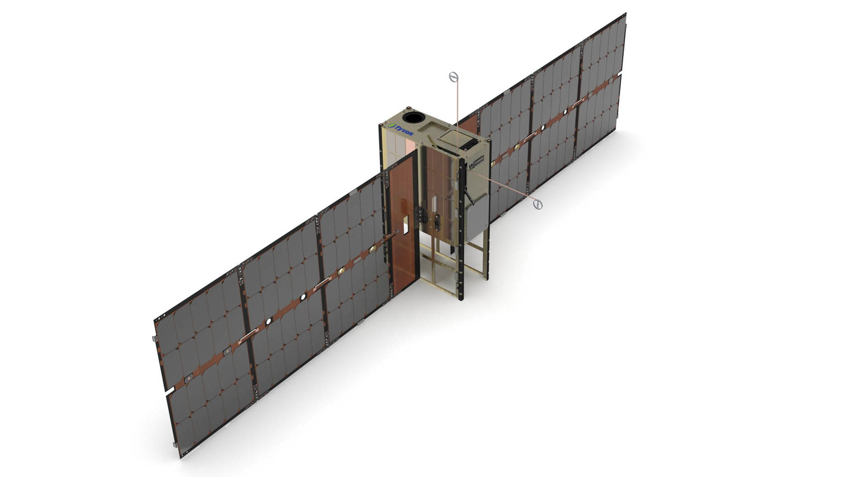
6U 120W Peak Solar Array Power
Notes:
Tyvak TRESTLES 6U

Slide 7
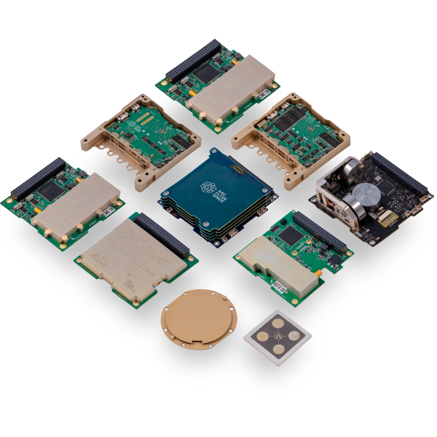
Cubesat Bits

Slide 8
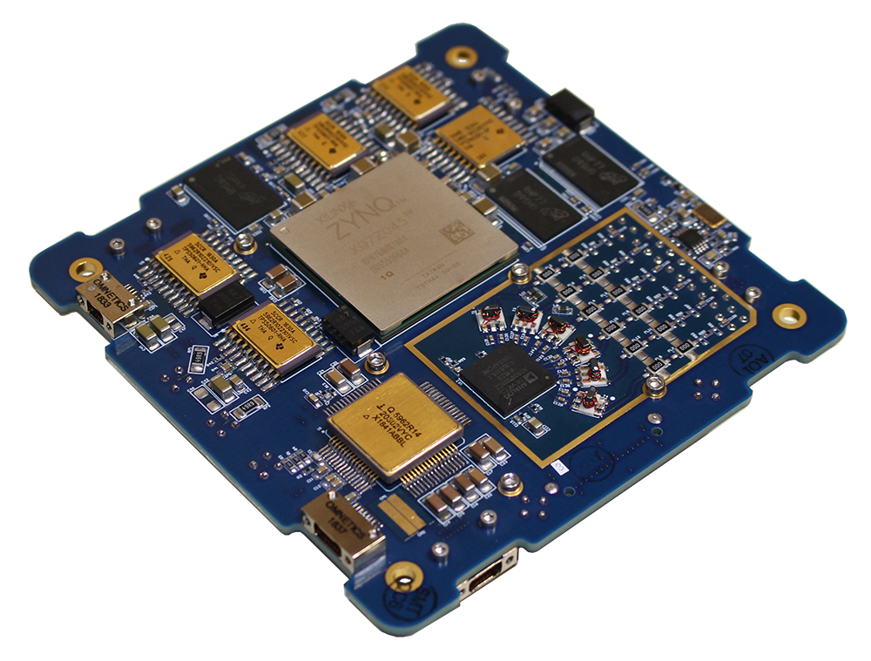
RINCON AstroSDR

Slide 9
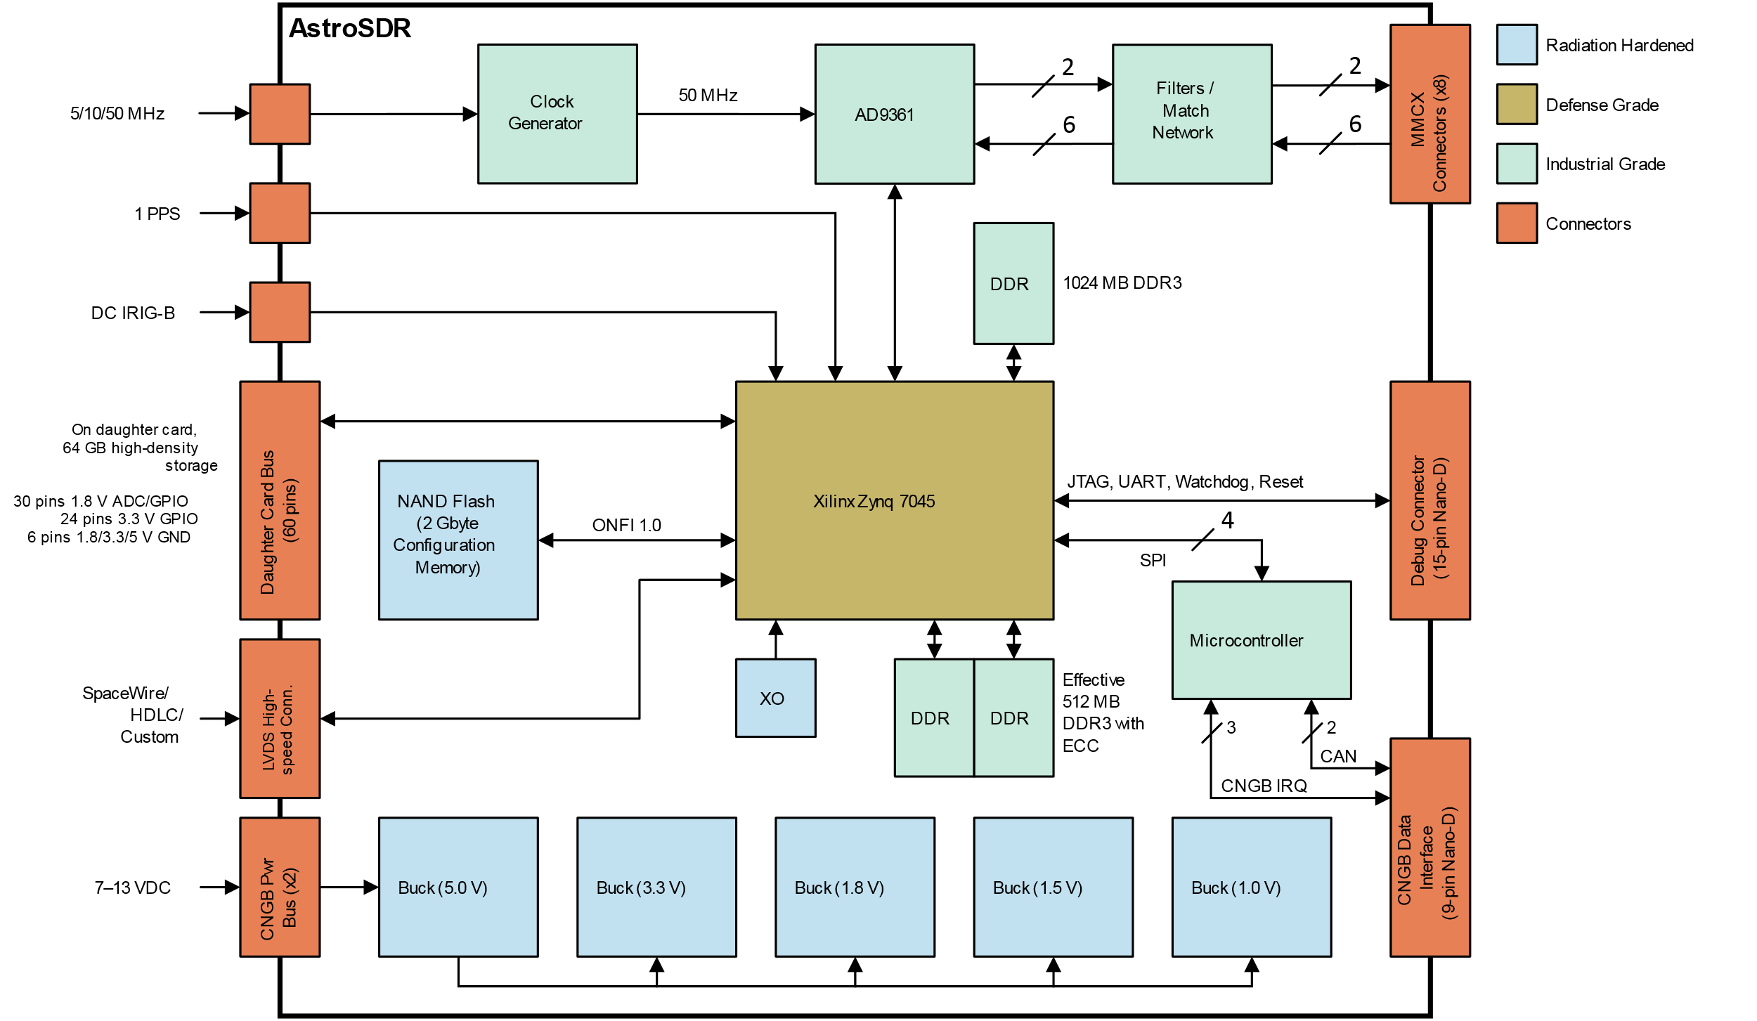
AstroSDR Block Diagram

Slide 10
Why DVB-S2
DVB Standards are International, Free, and very widely used.
DVB-S2 is the 2nd Generation Standard
Generic Stream Encapsulation (GSE) used for the downlink data.
QUASI Error Free (QER)

Slide 11
DVB-S2 Features
Continuous Transmission of frames at symbol rate.
Modulation and Coding (MODCOD) can vary with each frame.
Very Powerful Forward Error Correction (FEC)
Low Density Parity Check (LDPC) codes are nearly ideal. Amateur radio has access to open source implementations.

Slide 12
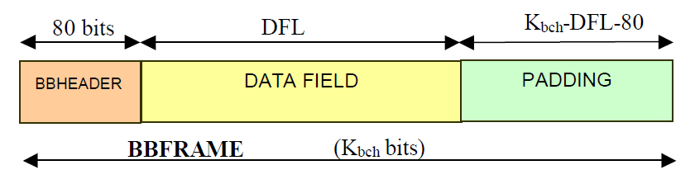
BBFRAME (BaseBand)

Slide 13
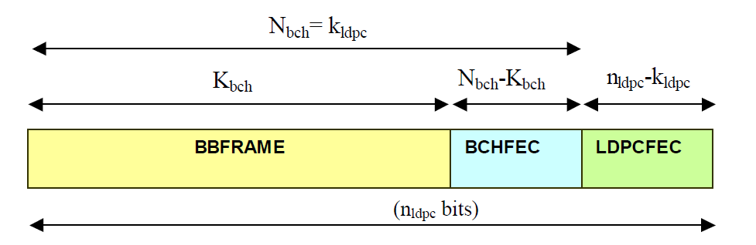
FEC FRAME

Slide 14
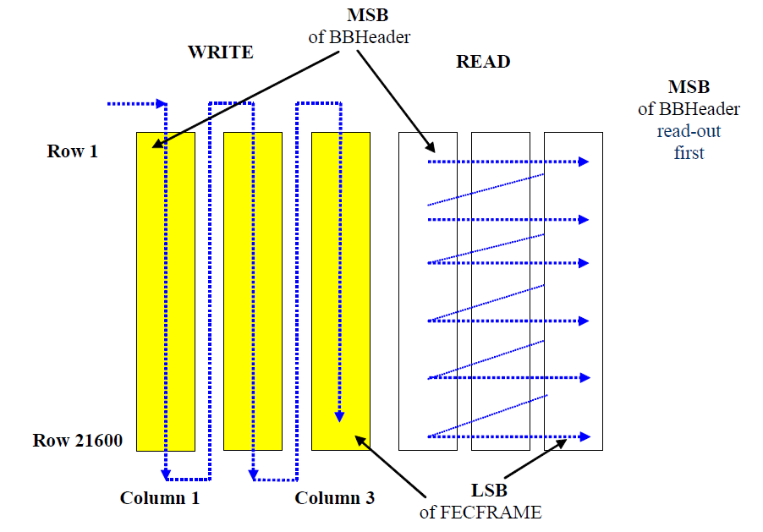

Slide 15
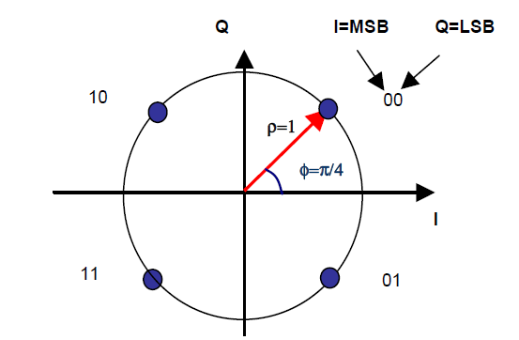
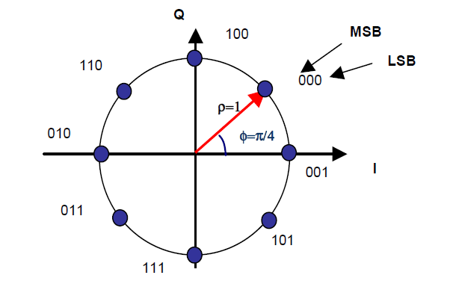
Constellation Mapping
QPSK
8PSK

Slide 16
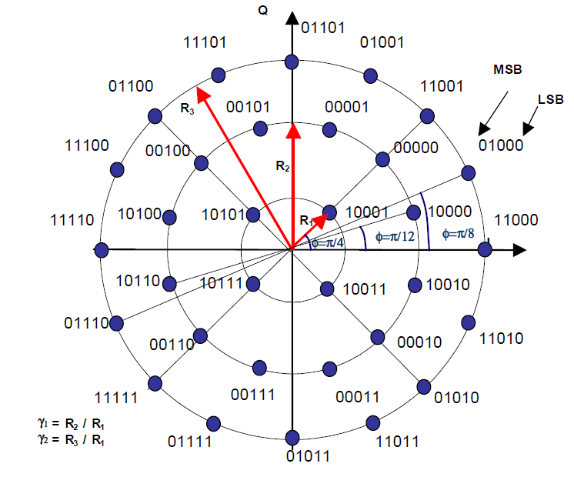
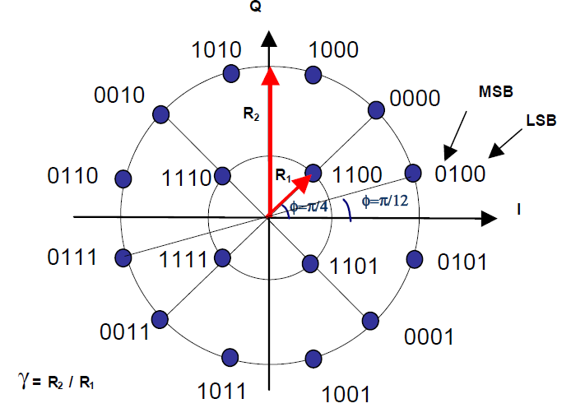
Linear Modulations Mapping
16 APSK
32 APSK

Slide 17
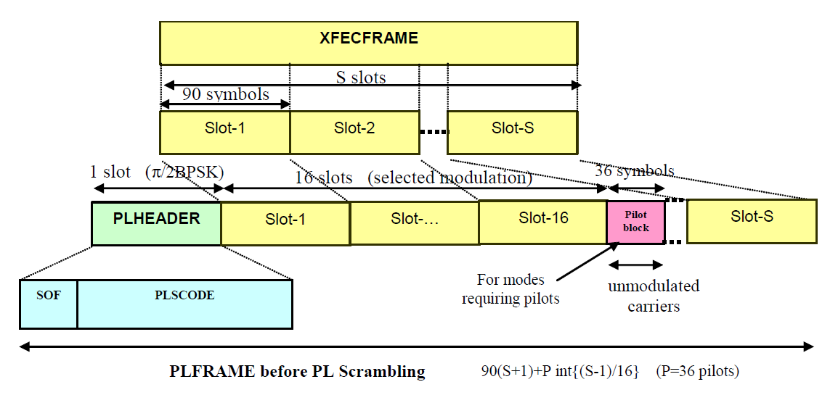
PLFRAME (Physical Layer)

Slide 18
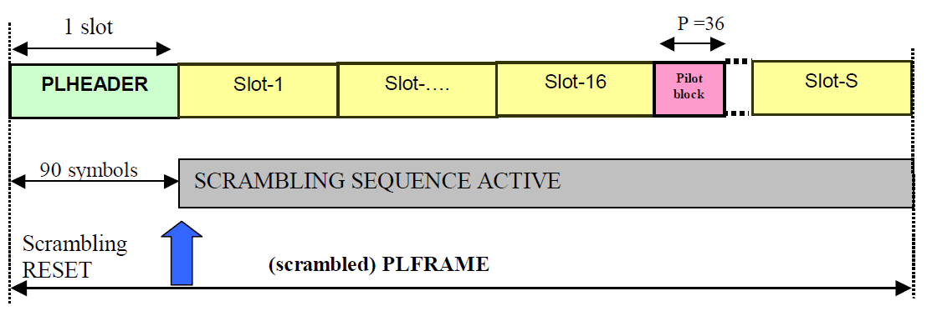
PL Scrambler

Slide 19
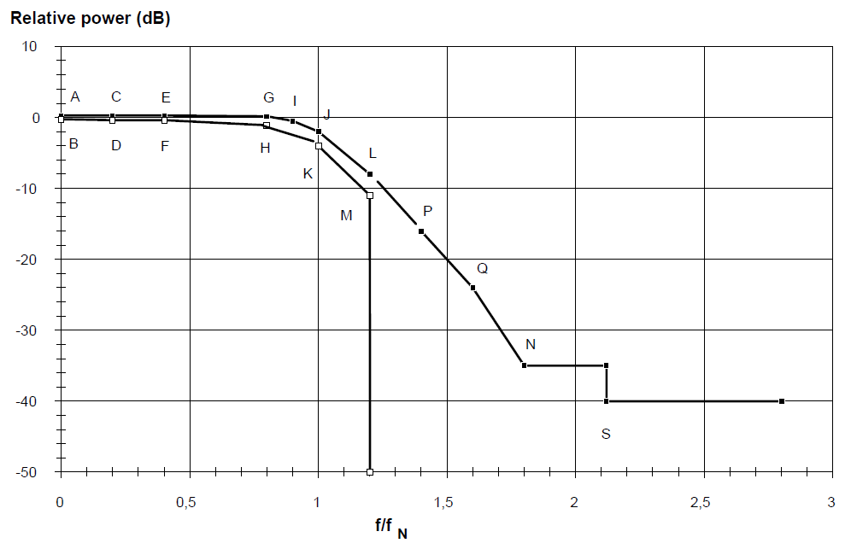
Rolloff (.35 Shown)

Slide 20
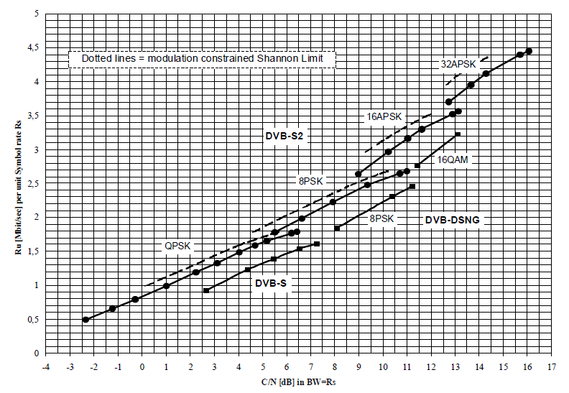
DVB-S2 Performance

Slide 21
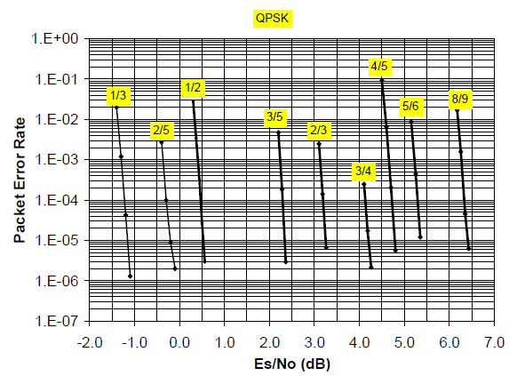

Slide 22
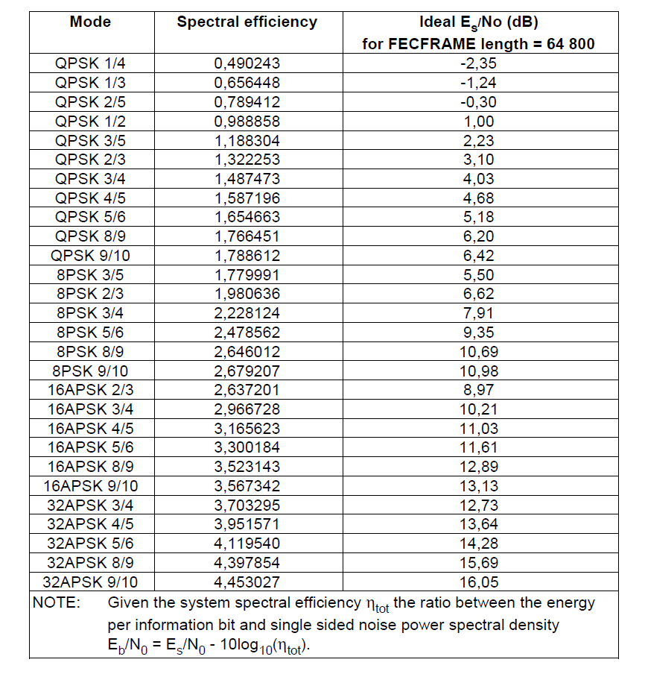
DVB-S2 Performance

Slide 23
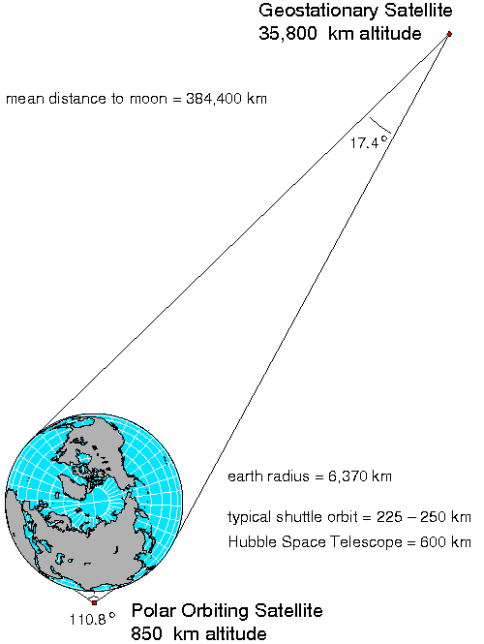
GEOMETRY
Notes:
Geometry.

Slide 24
P4XT Downlink
10.450 (typ) GHz Carrier
Single Downlink
Saturated Power Amplifier (maximize DC efficiency)
Up to 8+ Megasymbols per Second
DVB-S2 QPSK Modulation
ALL Stations synchronize to the downlink
Stations Decode streams they want (including all)

Slide 25
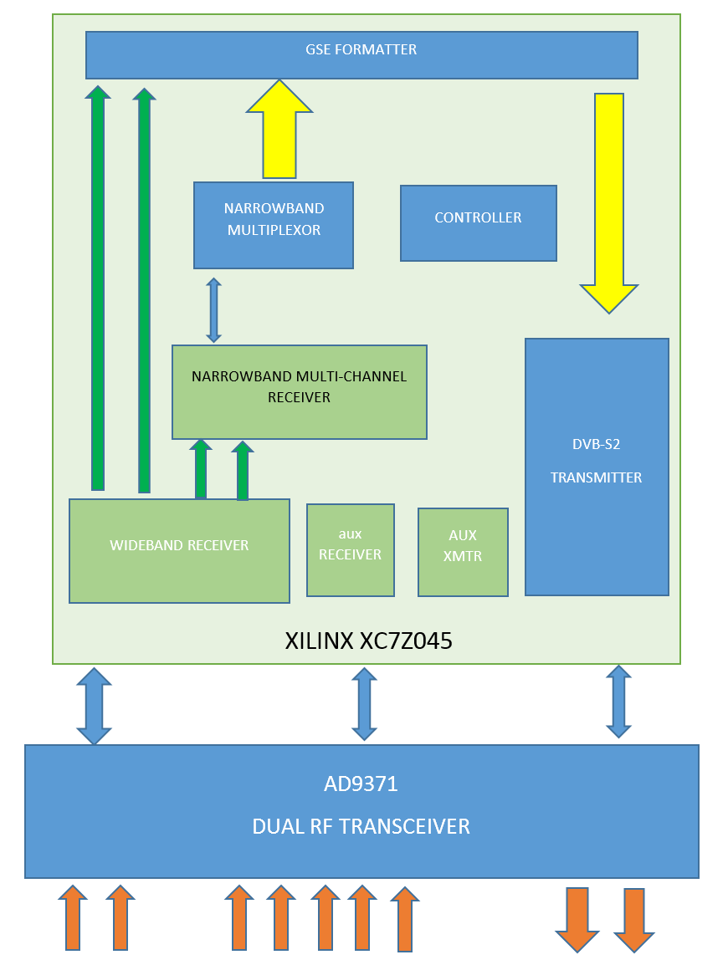

Slide 26
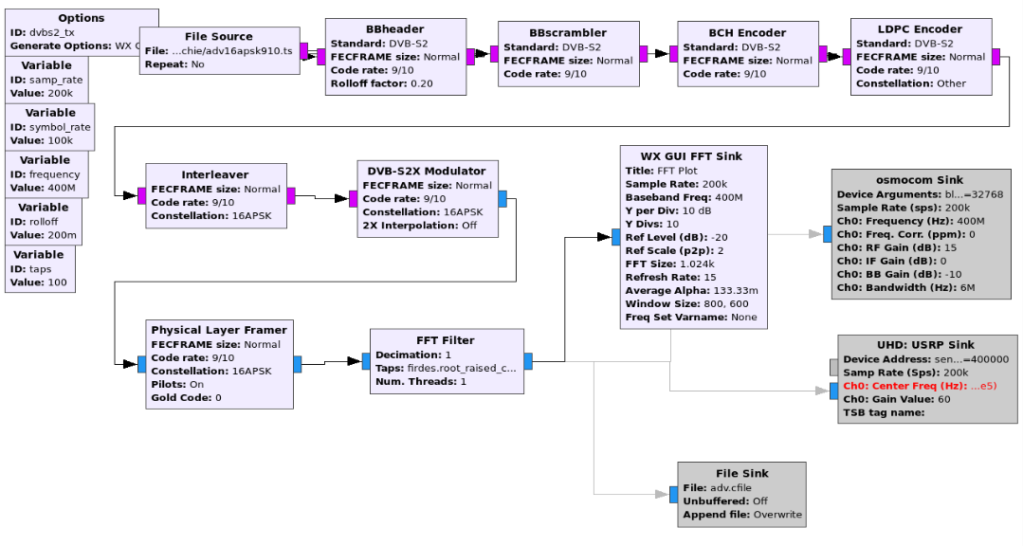
GR DVB-S2 Transmitter

Slide 27
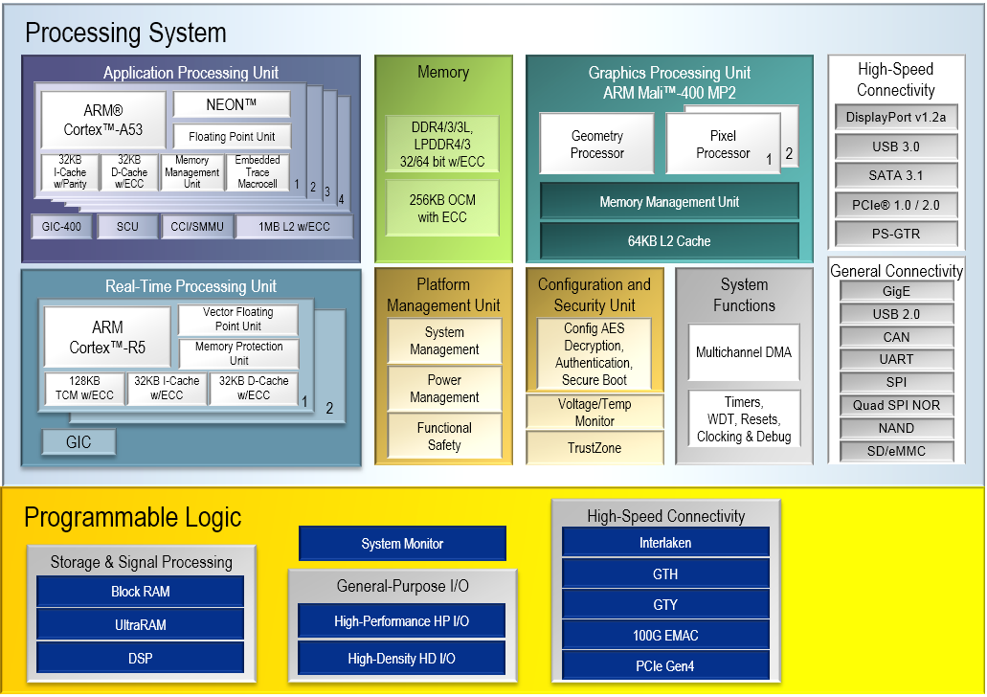
Ultrascale+ (16nm)

Slide 28
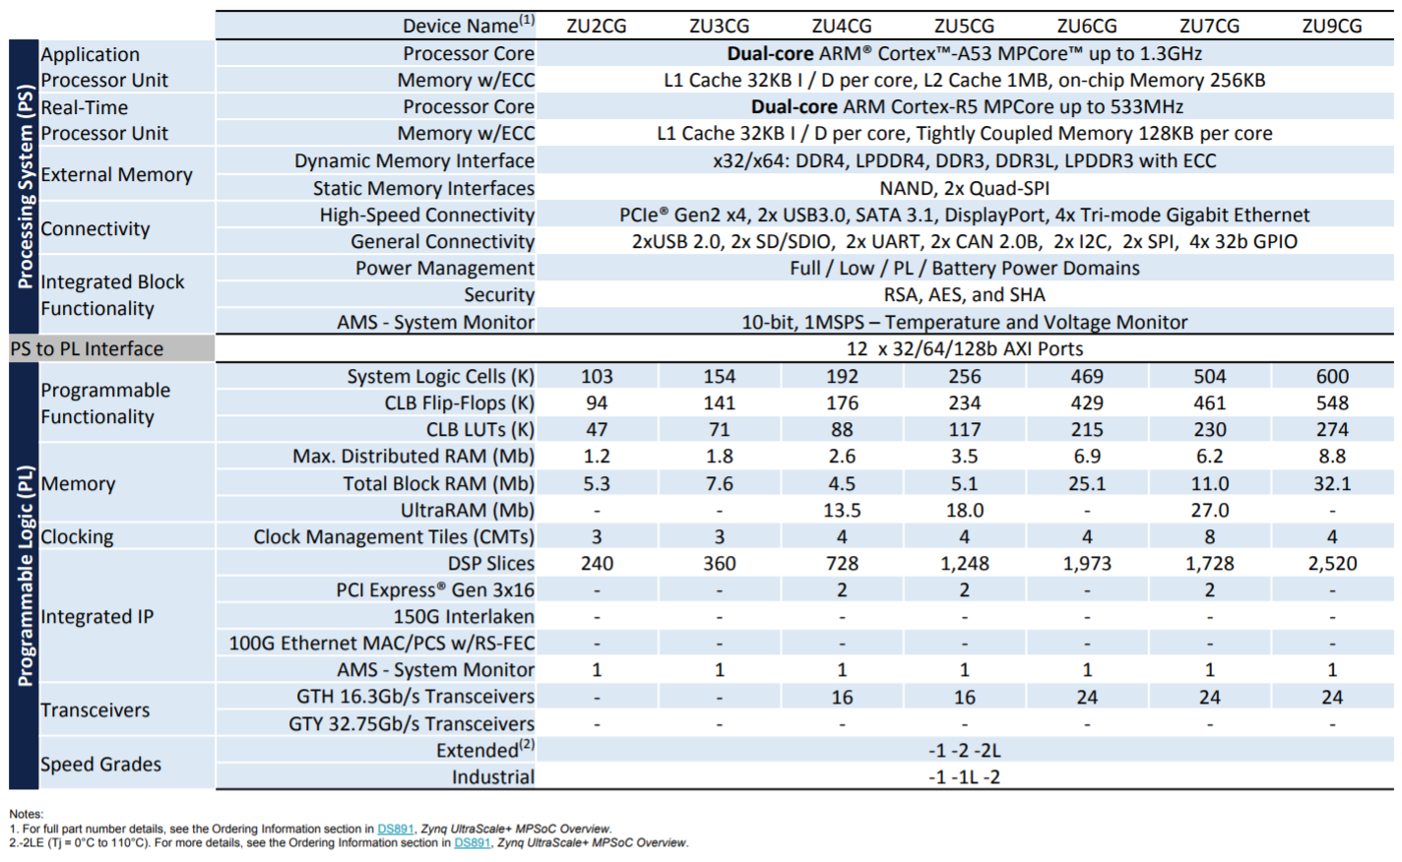
Ultrascale + MPSoC’s

Slide 29
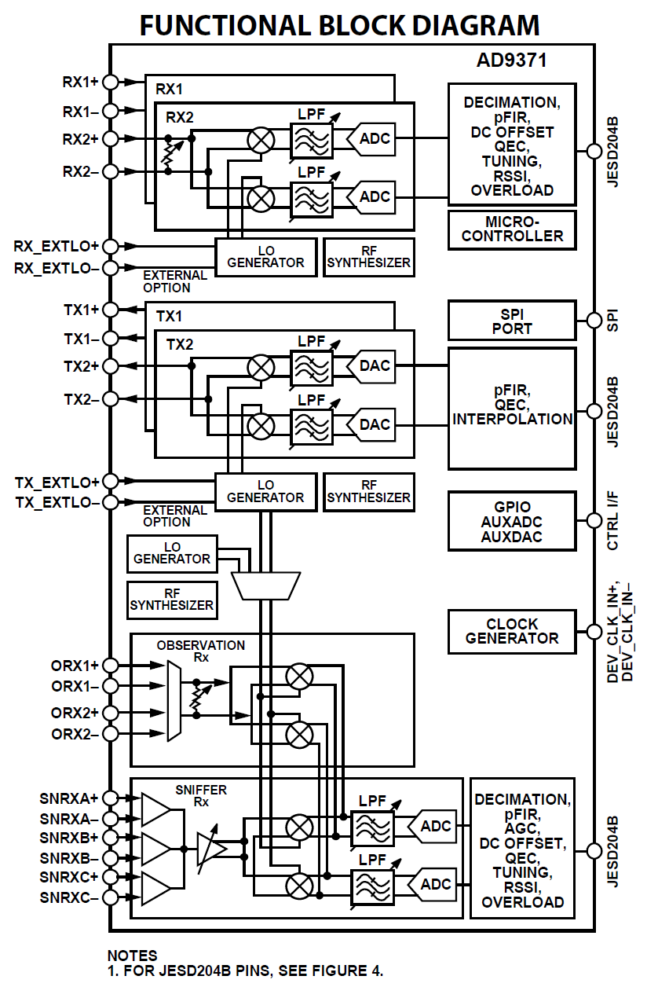

Slide 30
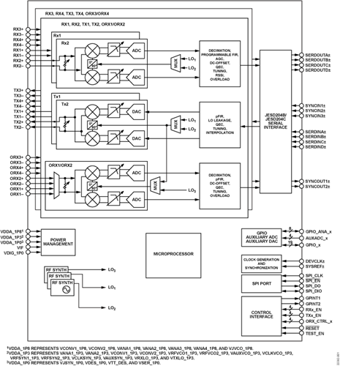

Slide 31
Notes:
The US Military already has a constellation of operational COMM satellites called MUOS. Mobile User Objective System.
The three operational satellites provide global coverage (with a 4th on orbit spare).
Four ground stations or Radio Access Facilities (RAF) each have 2 satellites in view. Each satellite can see two RAF’s.

Slide 32
Notes:
MUOS Terminals operate in UHF for both uplink and downlink.
RAFs Operate in Ka band.
Two hops are always required.

Slide 33
2.4 GHz
10.5 GHz
Notes:
Phase 4A may be able to be used in a ground repeater mode. Conceptually similar to MUOS.
The narrow band uplinks are received by a central Earth Station, Multiplexed into a DVB-S2 carrier, which is uplinked.
All small stations transmit on 2.4 and receive on 10.5 GHz

Slide 34
Repeater Mode Advantages
Only DVB-S2 Receiver Required. (No need for existing transceiver and transverter)
Simple Digital Transmitter on 2.4GHz uplink, 2W
Digital Voice
Expensive Equipment only at Central Station
Coexistence with Analog Modes

Slide 35
Documents
System Architecture Reference (Roadmap)
Downlink Specification
Narrowband Uplink Specification
Wideband Uplink Specification
Narrowband Multiplexor Specification
Application/Radio API

Slide 36
DMT TEAMS
DVB-S2 Transmitter
FRAMER
Narrowband Multiplexor
Wideband Multichannel Receiver (100kHz) x 32/64
Narrowband Multichannel Receiver (10kHz) x 128/256
Channel Acquisition Protocol Controller (C/C++)
System Management (C/C++)
Build/Integration
RF Team
PCBA Team
Project Management

Slide 37
P4XM Teams (Modem)
Application Processor Team (UI etc)
Driver Team (PI4 to Modem)
FPGA Glue Team
Modulator Team
PCBA Design Layour Team

Slide 38
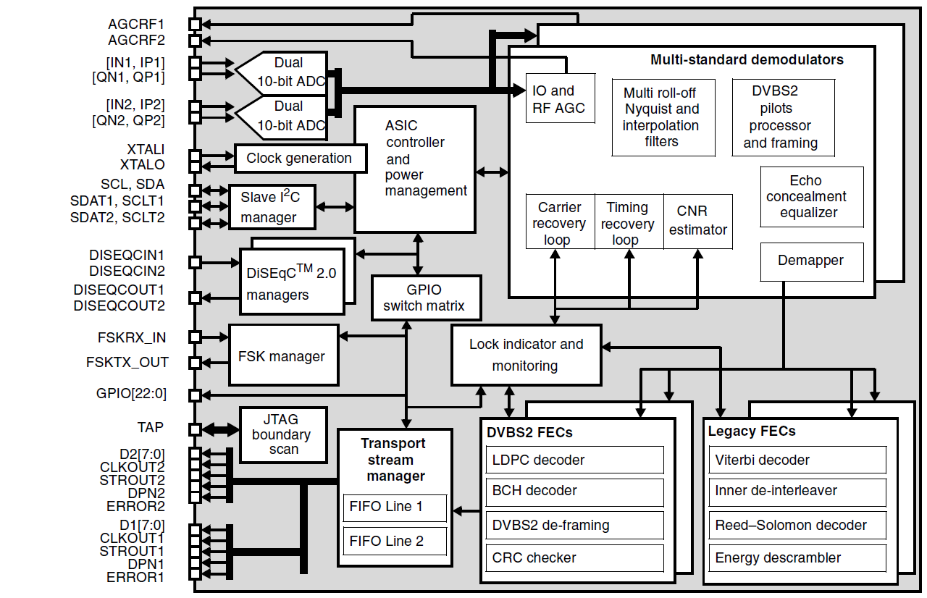
DVB-S2 Demodulator

Slide 39
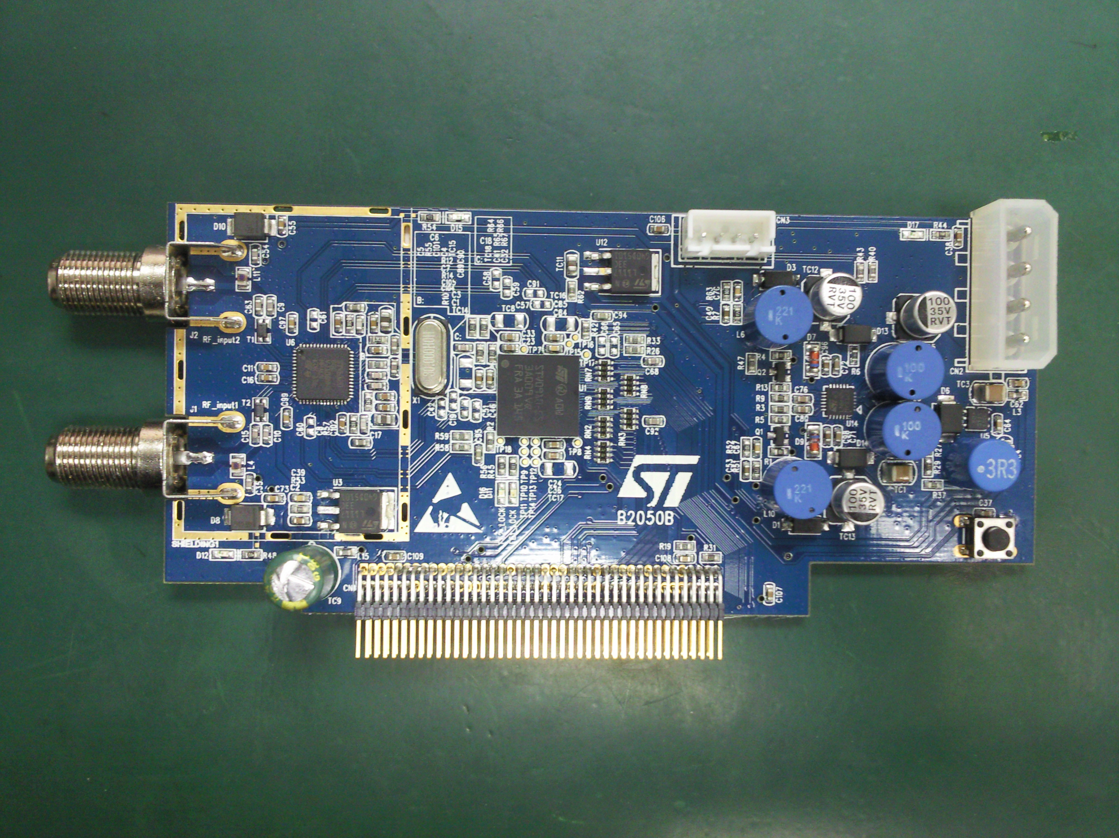
STV-910 Reference Design

Slide 40
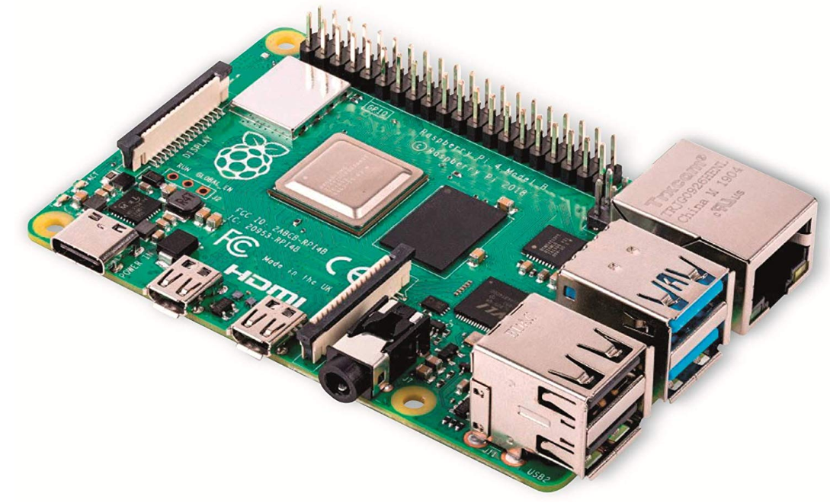
Raspberry Pi-4B

Slide 41
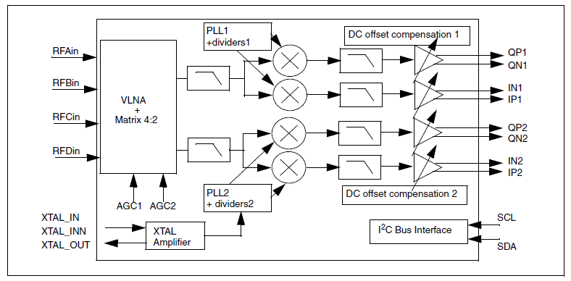
Tuner

Slide 42
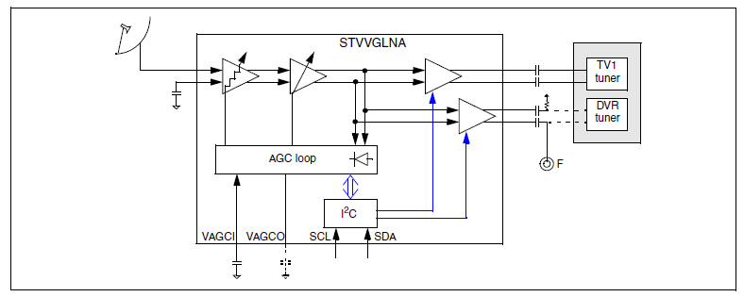
VLNA (50 – 2150 MHz)

Slide 43
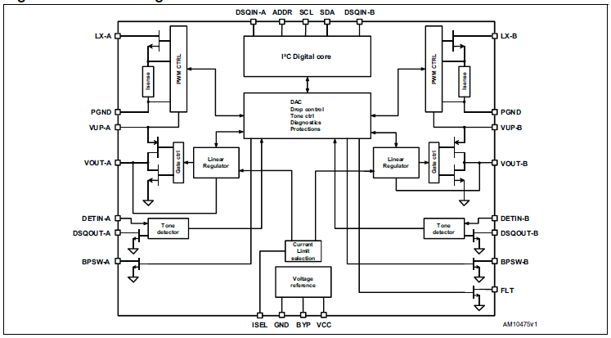
LNBH26

